Slide 1


Electromagnetic Form Factors of baryon in Time-like
Xiaorong Zhou
University of Science and Technology of China
Workshop on Frontiers in Timelike Physics and Nonperturbative Methods
12-16 Jan. 2026, Huizhou

Slide 2
Introduction

Slide 3


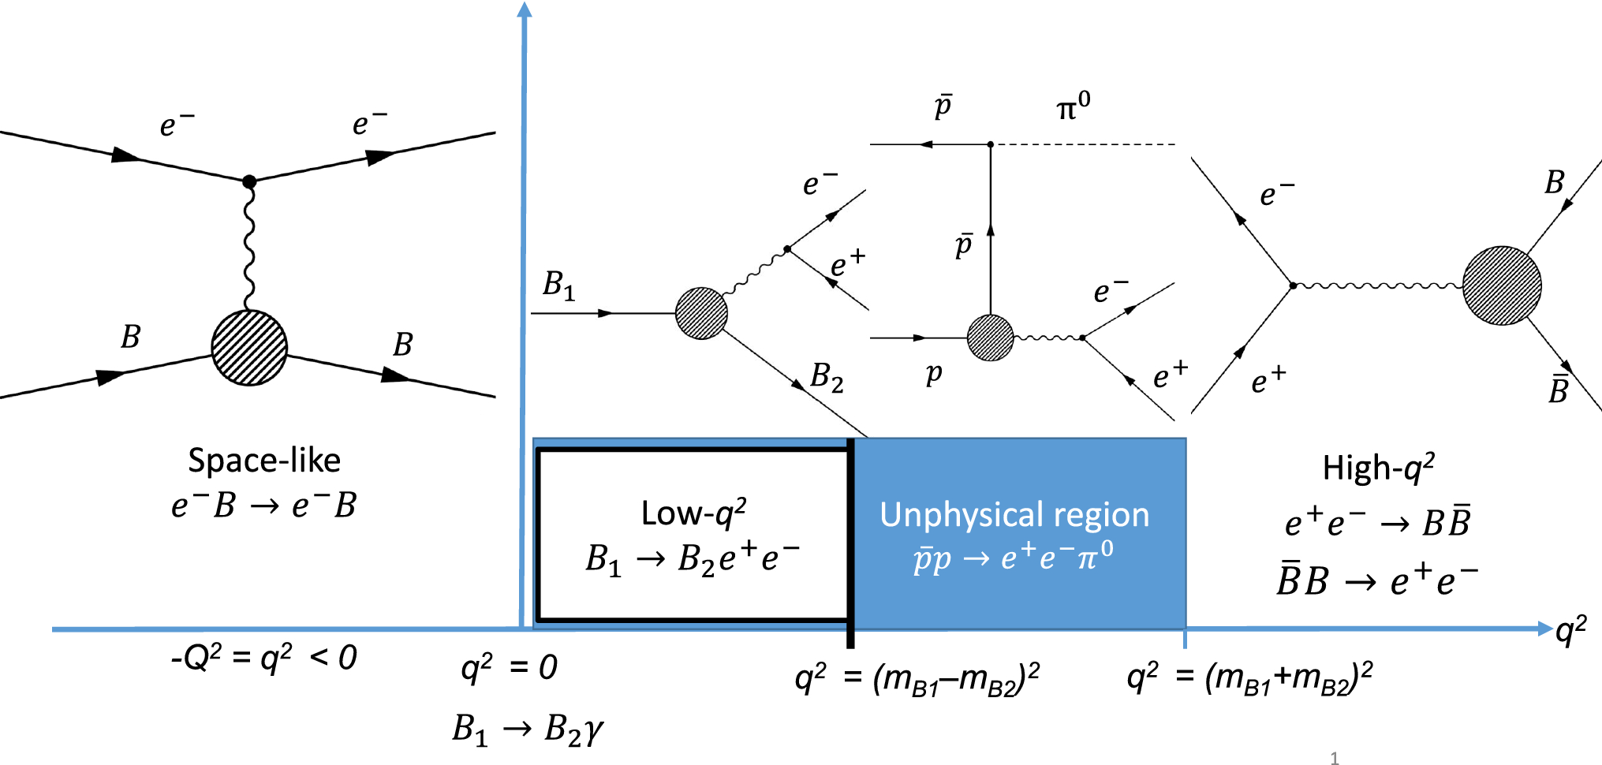

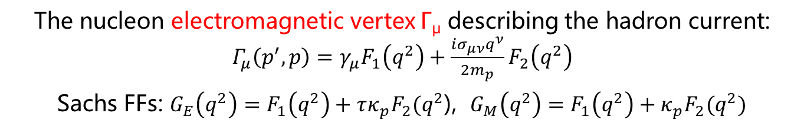
Electromagnetic Form Factors (EMFFs)
Electromagnetic Form Factors are fundamental properties of the nucleon
Connected to charge, current distribution
Crucial testing ground for models of the nucleon internal structure
The nucleon electromagnetic vertex Γ_{μ} describing the hadron current: $Γ_{μ}\left(p^{′},p\right)=γ_{μ}F_{1}\left(q^{2}\right)+\frac{iσ_{μν}q^{ν}}{2m_{p}}F_{2}\left(q^{2}\right)$
Sachs FFs: $G_{E}\left(q^{2}\right)=F_{1}\left(q^{2}\right)+τκ_{p}F_{2}(q^{2}$), $G_{M}\left(q^{2}\right)=F_{1}\left(q^{2}\right)+κ_{p}F_{2}(q^{2})$

Slide 4
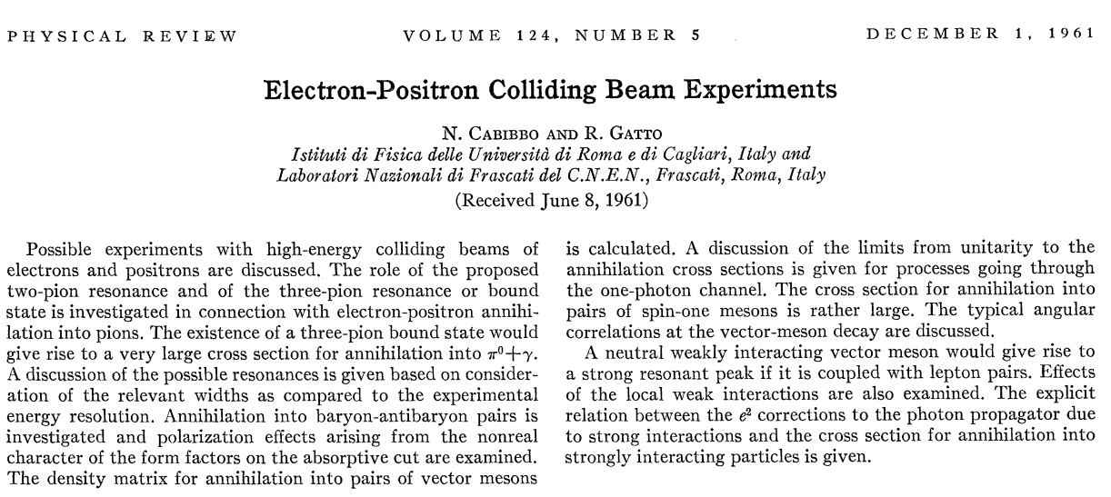
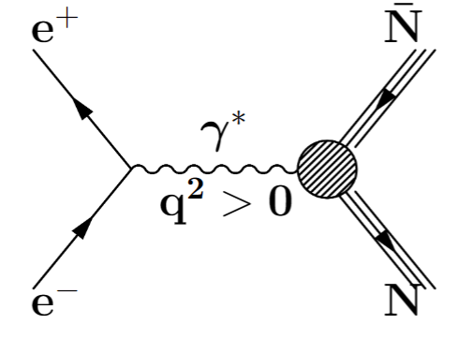
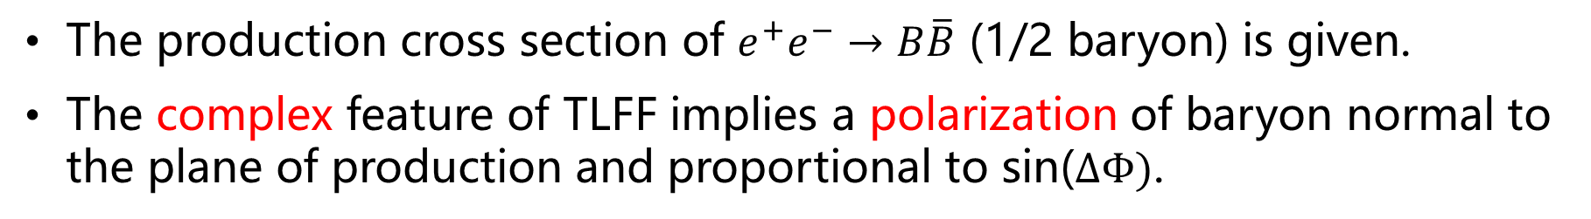
Time-like EMFFs: theoretic review
1961, first paper by N. Cabibbo and R. Gatto
Phys.Rev. 124 (1961) 1577-1595
The production cross section of $e^{+}e^{−}→B\overline{B}$ (1/2 baryon) is given.
The complex feature of TLFF implies a polarization of baryon normal to the plane of production and proportional to sin($∆Φ)$.

Slide 5
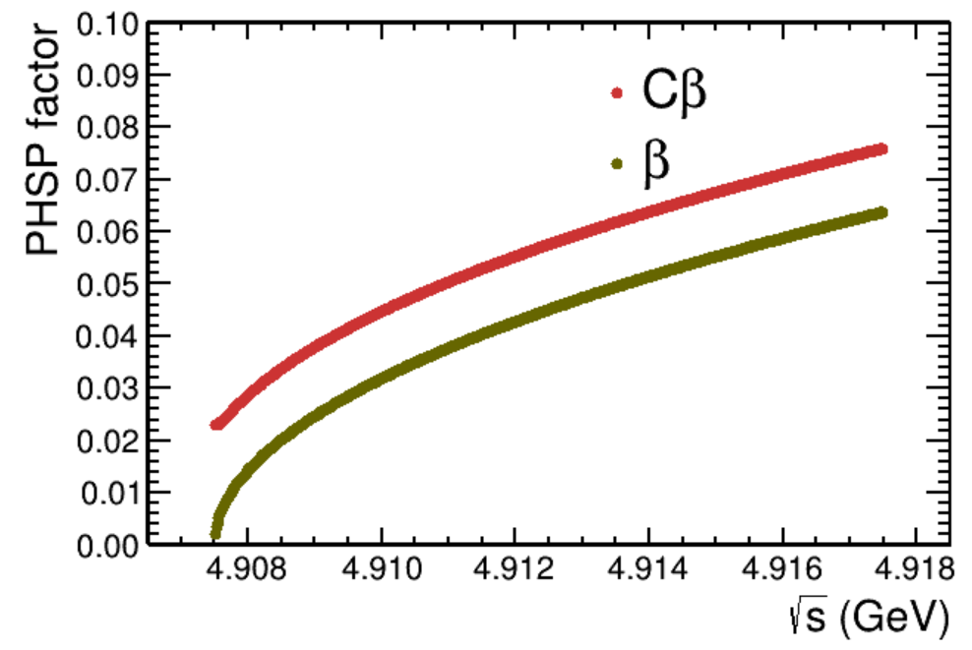
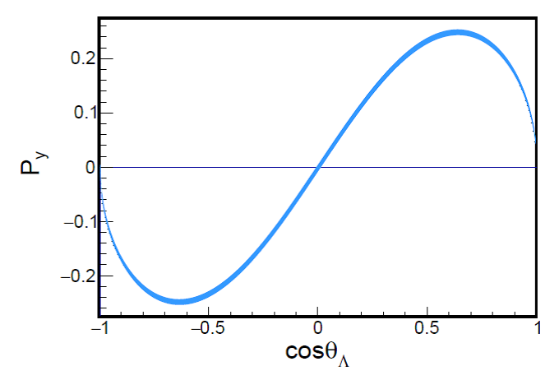
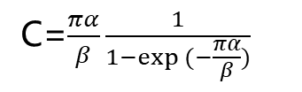
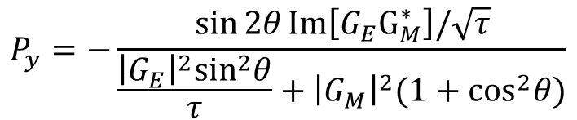
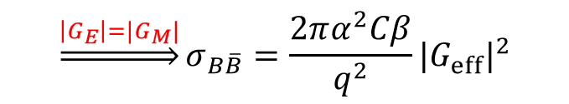
Time-like EMFFs: theoretic review
Interaction of final states, lead to a non-zero cross section for charged baryon at threshold.
Sov. Phys. Usp. 34 375(1991)
$\frac{dσ_{B\overline{B}}}{dcosθ}=\frac{πα^{2}Cβ}{2q^{2}}\left[\left(1+\cos^{2}θ\right){\left|G_{M}\right|}^{2}+\frac{1}{τ}{\left|G_{E}\right|}^{2}\sin^{2}θ\right],$ $τ=\frac{q^{2}}{4m_{B}^{2}}$
C=$\frac{πα}{β}\frac{1}{1−exp (−\frac{πα}{β})}$
Integrated version: $σ_{B\overline{B}}=\frac{4πα^{2}Cβ}{3q^{2}}\left[{\left|G_{M}\right|}^{2}+\frac{1}{2τ}{\left|G_{E}\right|}^{2}\right]$
$$\underset{⇒}{\left|G_{E}\right|=|G_{M}|}σ_{B\overline{B}}=\frac{2πα^{2}Cβ}{q^{2}}|G_{eff}|^{2}$$
Complex form of TLFFs leads to transversely polarized baryon even the beams are unpolarized
Nuov Cim A 109, 241–256 (1996)
$$P_{y}=−\frac{\sin{2θ}Im\left[G_{E}G_{M}^{∗}\right]/\sqrt{τ}}{\frac{{\left|G_{E}\right|}^{2}\sin^{2}θ}{τ}+{\left|G_{M}\right|}^{2}(1+\cos^{2}θ)}$$

Slide 6
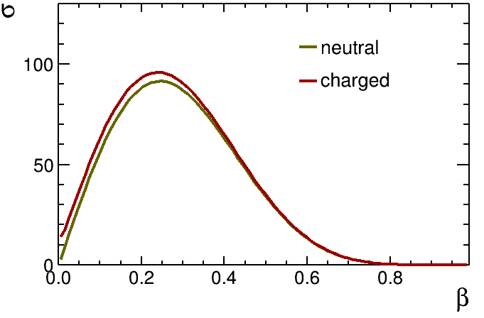
Time-like EMFFs: theoretic review
Various theoretical models describe TLFF in non-perturbative region: ChEFT, VMD, Relativistic CQM, parton model, pQCD etc.
Parametrization of TLFF:
pQCD predicts continuous transition at high q², with the scaling behavior: $F_{1}∝q^{−4}, F_{2}∝q^{−6}$
pQCD predicts continuous transition at high q², with the scaling behavior: 𝑭_𝟏∝𝒒^(−𝟒), 𝑭_𝟐∝𝒒^(−𝟔)
Modified scaling expression in nonperturbative region: $\frac{q^{2}F_{2}}{F_{1}}∝ln(\frac{q^{2}}{Λ^{2}})$, with $Λ≈0.3$ GeV
Modified scaling expression in nonperturbative region: (𝒒^𝟐 𝑭_𝟐)/𝑭_𝟏 ∝𝐥𝐧(𝒒^𝟐/𝜦^𝟐 ), with Λ≈0.3 GeV
VMD model described the effect of meson cloud $\left|G_{eff}\right|=\frac{𝓐}{q^{4}[\ln^{2}\left(\frac{q^{2}}{Λ^{2}}\right)+π^{2}]}$ or $\left|G_{eff}\right|=\frac{𝓐}{\left(1+\frac{q^{2}}{m_{a}^{2}}\right)[1−q^{2}/q_{0}^{2}]^{2}}$
VMD model described the effect of meson cloud |𝑮_𝐞𝐟𝐟 |=𝓐/(𝒒^𝟒 [〖𝐥𝐧〗^𝟐 (𝒒^𝟐/𝜦^𝟐 )+𝝅^𝟐]) or |𝑮_𝐞𝐟𝐟 |=𝓐/((𝟏+𝒒^𝟐/(𝒎_𝒂^𝟐 ))[𝟏−𝒒^𝟐/𝒒_𝟎^𝟐 ]^𝟐 )
Dispersion theoretical analysis, provide a coherent framework for the joint interpretation of SL and TL EMFFs over the entire physical range of q².

Slide 7
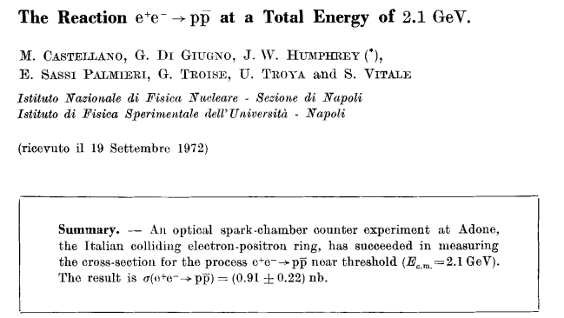
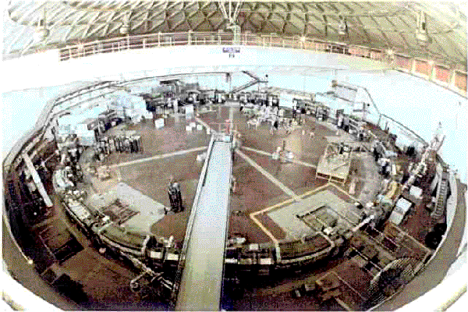
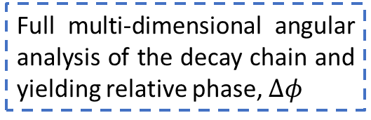
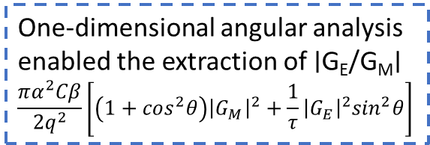
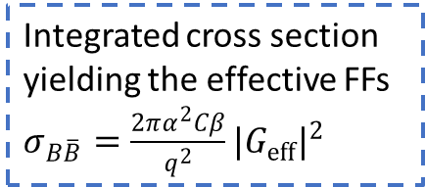
Time-like EMFFs: experimental review
1972，first experiment (ADONE)
Nuovo Cim.A 14 (1973) 1-20
Path toward the baryon EMFFs:
Integrated cross section yielding the effective FFs $σ_{B\overline{B}}=\frac{2πα^{2}Cβ}{q^{2}}|G_{eff}|^{2}$
One-dimensional angular analysis enabled the extraction of ∣G_{E}/G_{M}∣
$$\frac{πα^{2}Cβ}{2q^{2}}\left[\left(1+\cos^{2}θ\right){\left|G_{M}\right|}^{2}+\frac{1}{τ}{\left|G_{E}\right|}^{2}\sin^{2}θ\right]$$
Full multi-dimensional angular analysis of the decay chain and yielding relative phase, $∆φ$

Slide 8
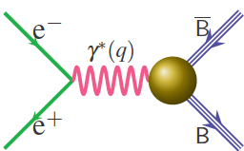
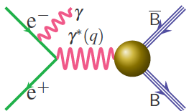





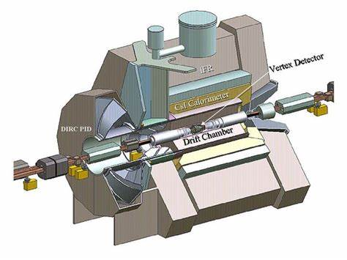
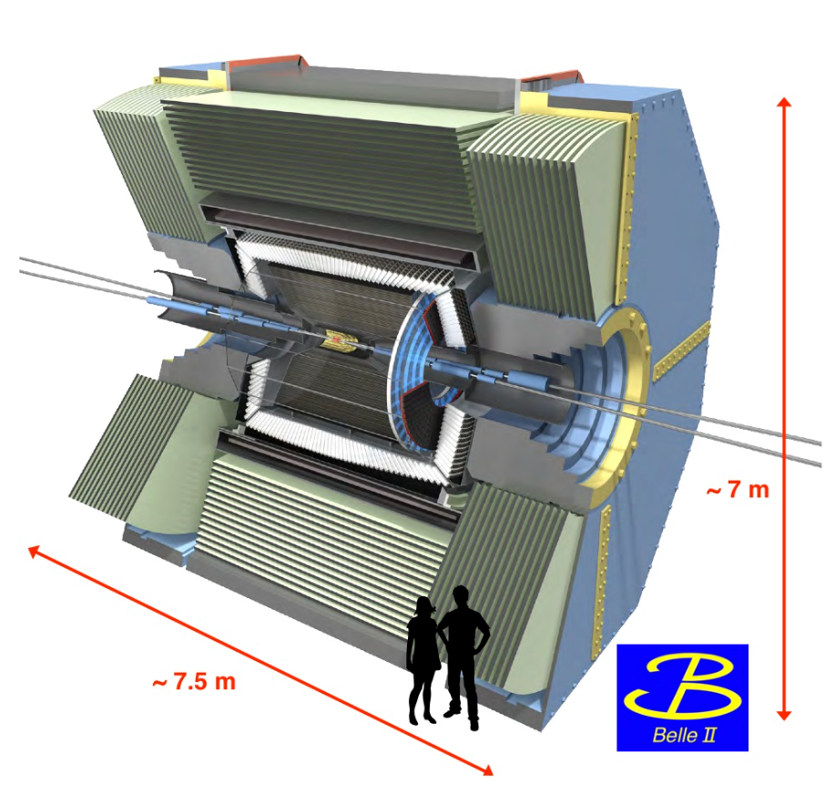
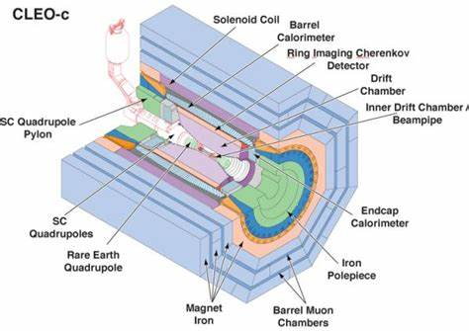
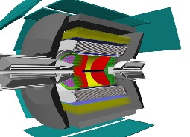
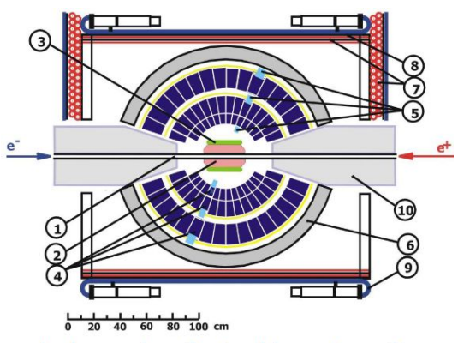
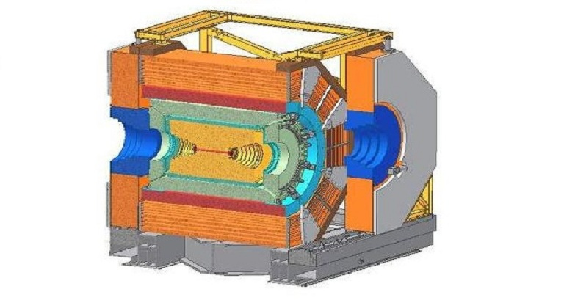
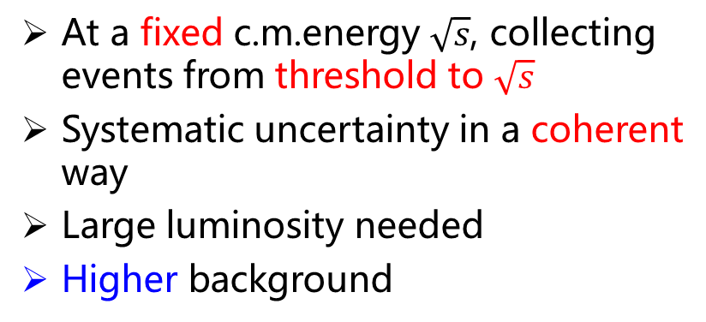
Time-like EMFFs: experiment review
Energy scan method at discrete c.m.energies
Initial state radiation method at a fixed c.m.energy
Well-defined c.m.energy, low background
Very good energy resolution
Discrete values, leaving gaps without information
At a fixed c.m.energy $\sqrt{s}$, collecting events from threshold to $\sqrt{s}$
Systematic uncertainty in a coherent way
Large luminosity needed
Higher background
CLEO-c
CMD-3

Slide 9
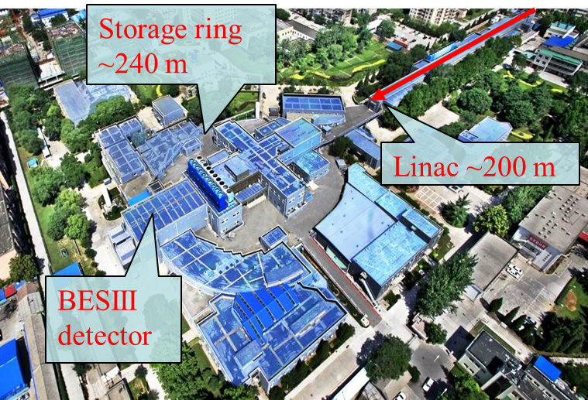
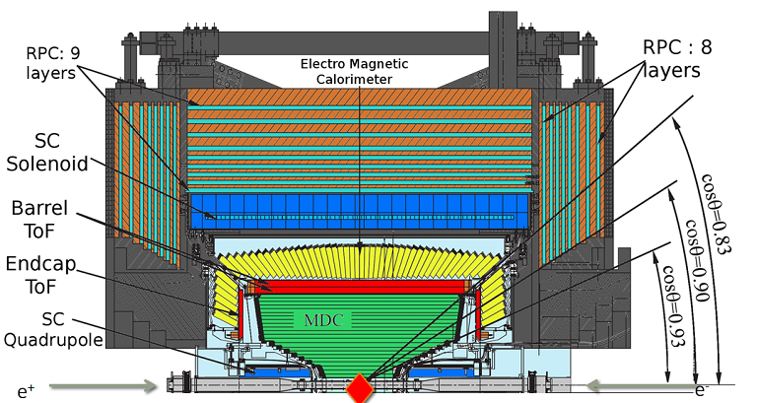
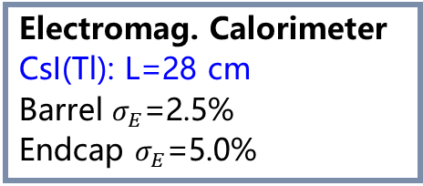
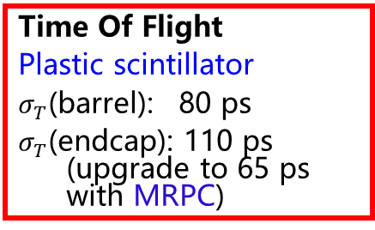
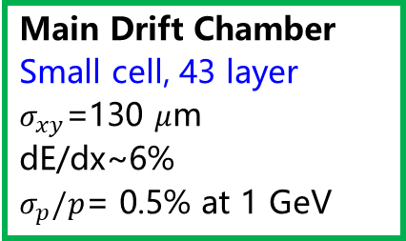


BEPCII & BESIII
Electromag. Calorimeter
CsI(Tl): L=28 cm
Barrel $σ_{E}$=2.5%
Endcap $σ_{E}$=5.0%
Muon Counter (RPC)
Barrel: 9 layers
Endcap: 8 layers
$σ_{spatial}$: 1.48 cm
E_{cm}= 1.84-4.95 GeV
Energy spread: $ΔE≈5×{10}^{−4}$
Peak luminosity: ~1.1$×{10}^{33}$ ${cm}^{−2}s^{−1}$
Main Drift Chamber
Small cell, 43 layer
$σ_{xy}$=130 $μ$m
dE/dx~6%
$σ_{p}/p$= 0.5% at 1 GeV
Time Of Flight
Plastic scintillator
$σ_{T}$(barrel): 80 ps
$σ_{T}$(endcap): 110 ps (upgrade to 65 ps with MRPC)

Slide 10
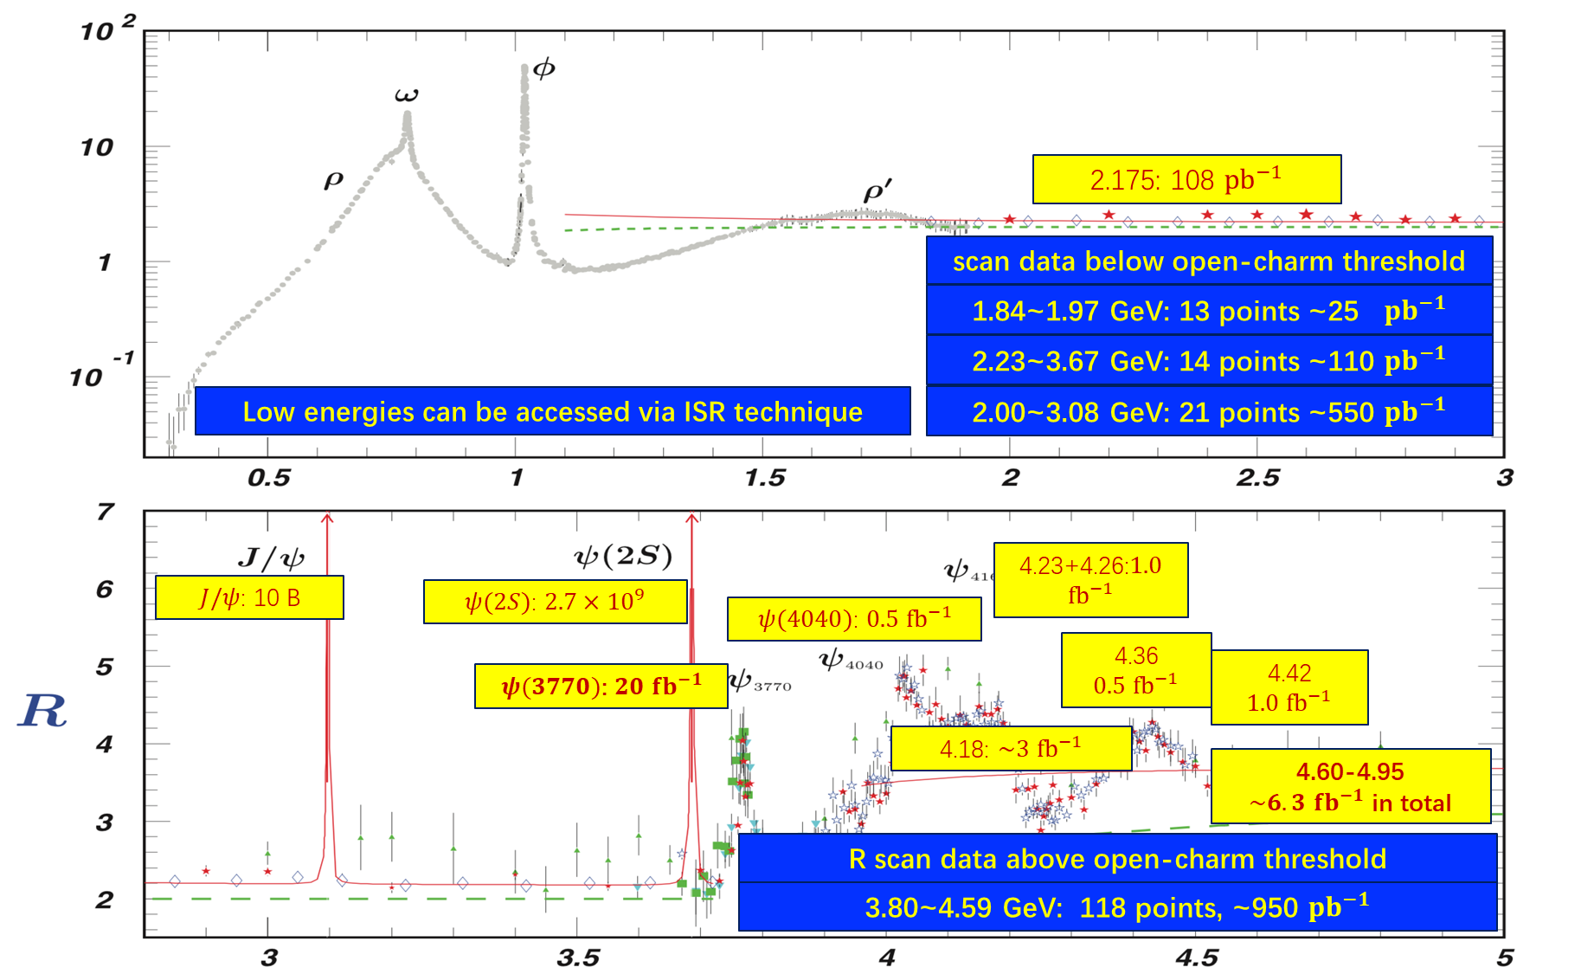
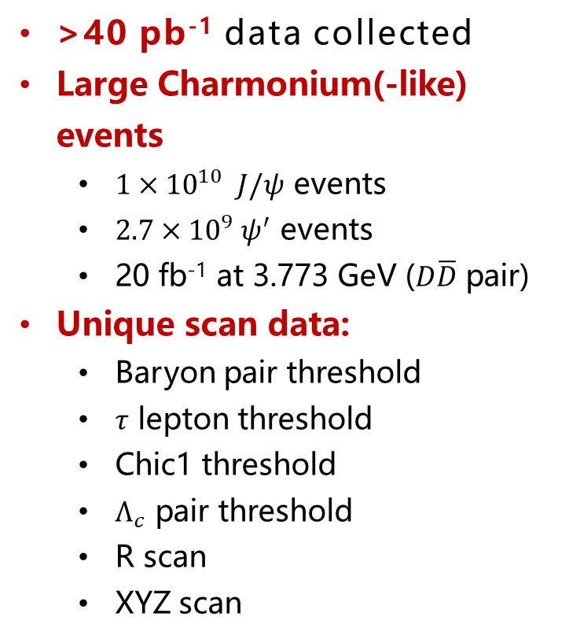
BESIII Data Samples
>40 pb⁻¹ data collected
Large Charmonium(-like) events
$1×{10}^{10} J/ψ$ events
$2.7×{10}^{9} ψ^{′}$ events
20 fb⁻¹ at 3.773 GeV ($D\overline{D}$ pair)
Unique scan data:
Baryon pair threshold
$τ$ lepton threshold
Chic1 threshold
$Λ_{c}$ pair threshold
R scan
XYZ scan
Threshold/pair production, quantum entanglement, clean env. etc.

Slide 11
Nucleons

Slide 12
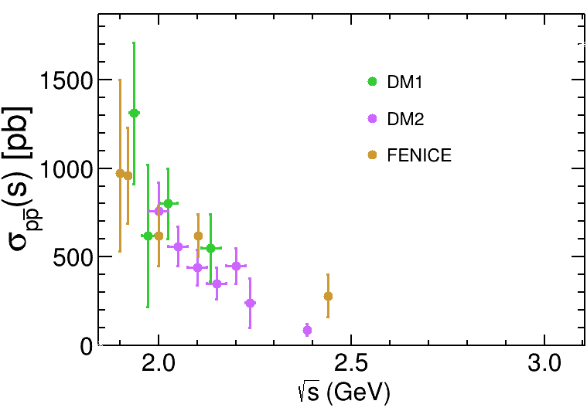
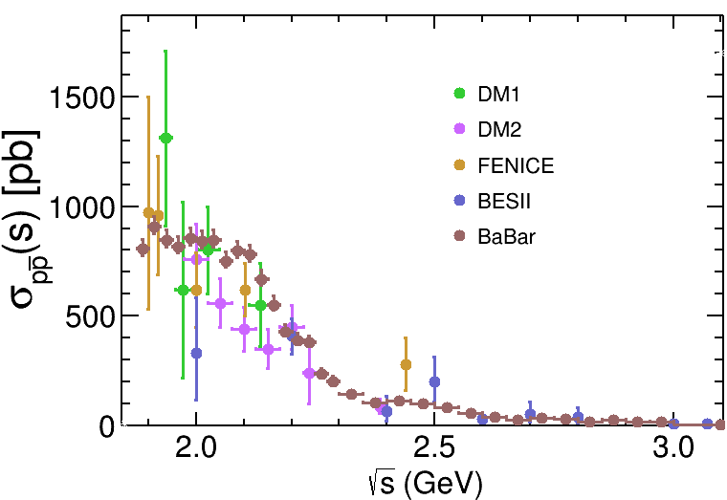
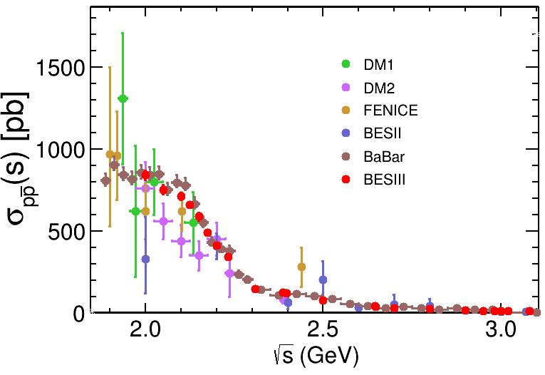
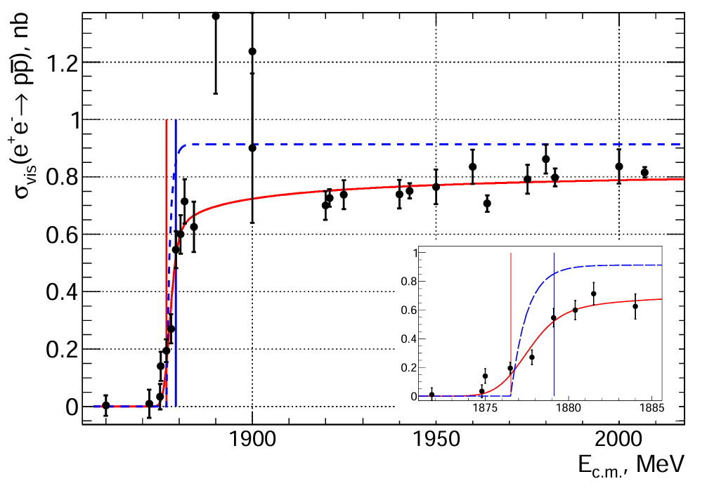
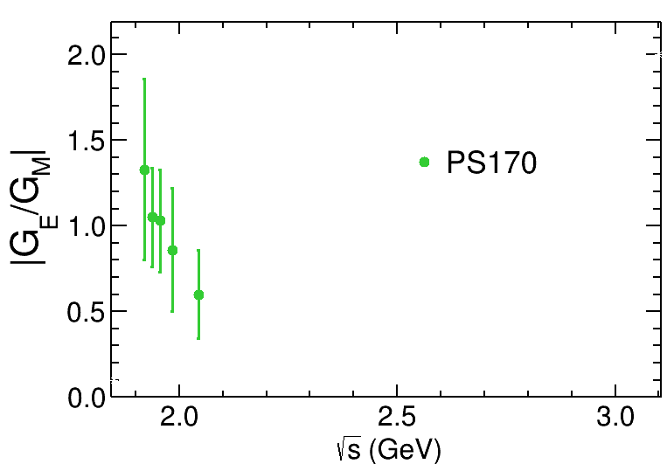
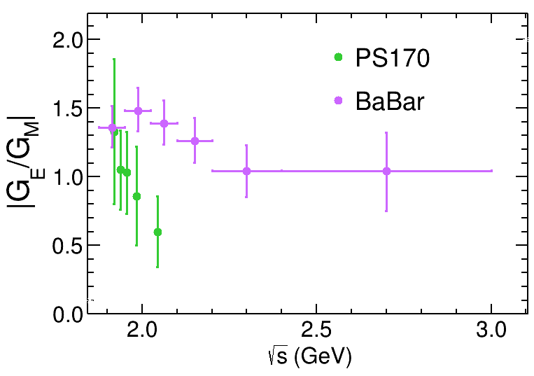
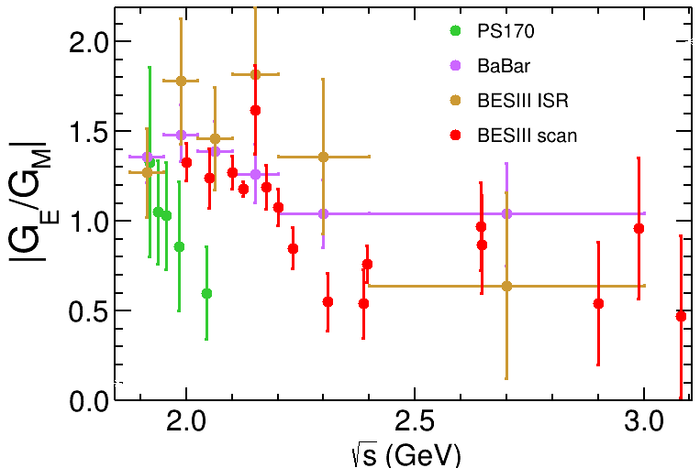
Timeline of Proton EMFFs
Cross section
200 signal events in total, limited narrow energy region
BaBar observed threshold effect via ISR
BESIII & CMD obtained best precision via energy scan at >2.0 GeV and near threshold
|G_{E}/G_{M}|
Before 2000
2000 to 2020
2020-2025
Year
PS170 observed |G_{E}/G_{M}| ratio for the first time at LEAR
Result from BaBar is inconsistent with PS170
BESIII observed oscillation in the |G_{E}/G_{M}| lineshape

Slide 13
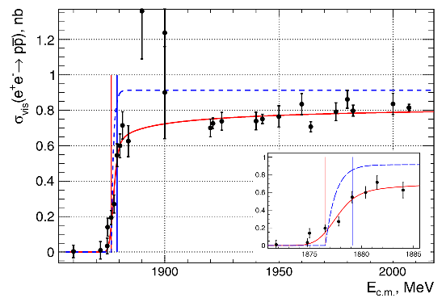
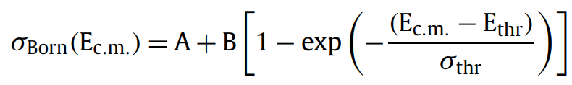
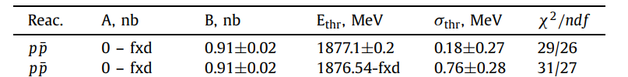

Recent results of proton EMFFs
CMD-3
Cross section of $e^{+}e^{−}→p\overline{p}$ near threshold shows very sharp step-like behavior.
The plateau indicates anomaly threshold effect in the production cross section.
PLB 794, 64-68 (2019)
The Born cross section is described with

Slide 14

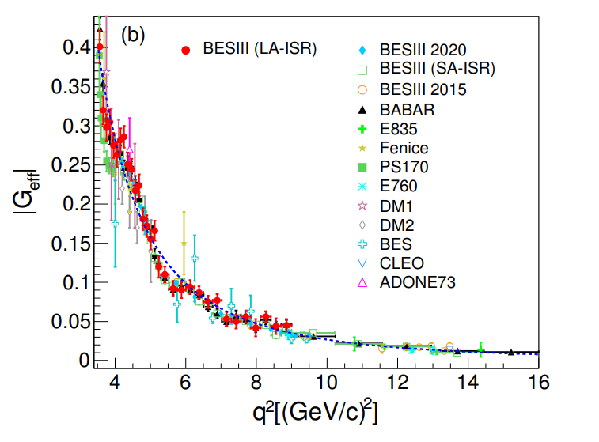
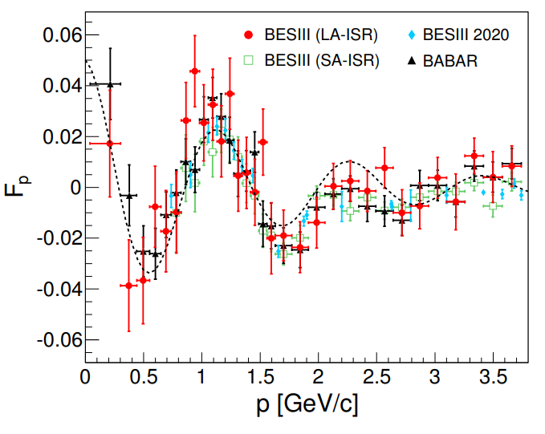


Recent results of proton EMFFs
ISR method with detected photon and undetected at BESIII.
Damped oscillation distribution after subtracting the modified dipole.
PLB 817, 136328 (2021)
Blue dashed:
Black dashed:

Slide 15
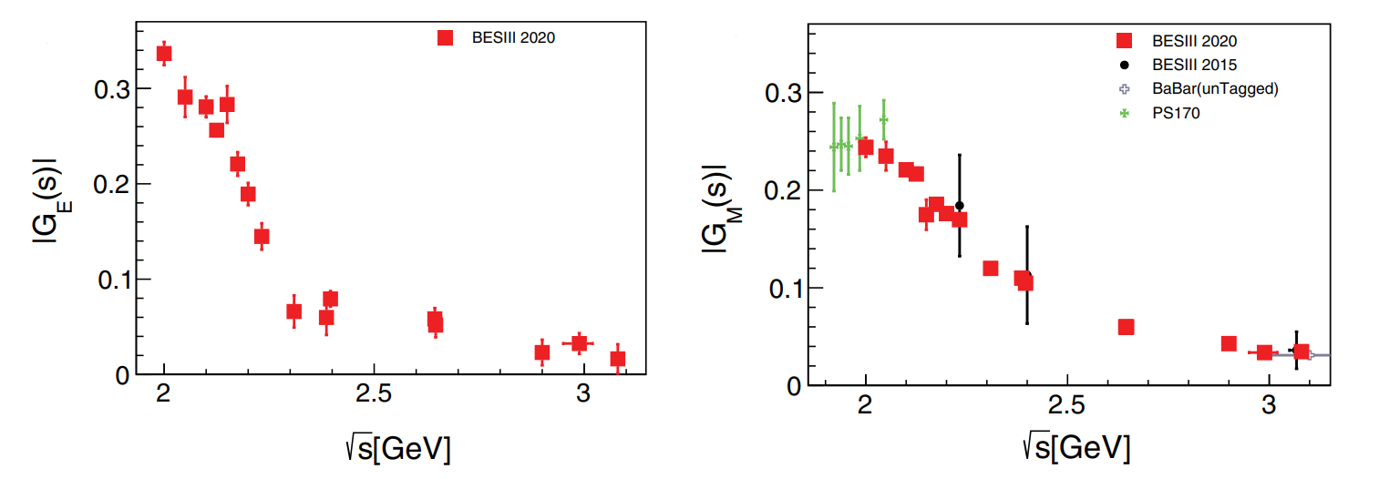
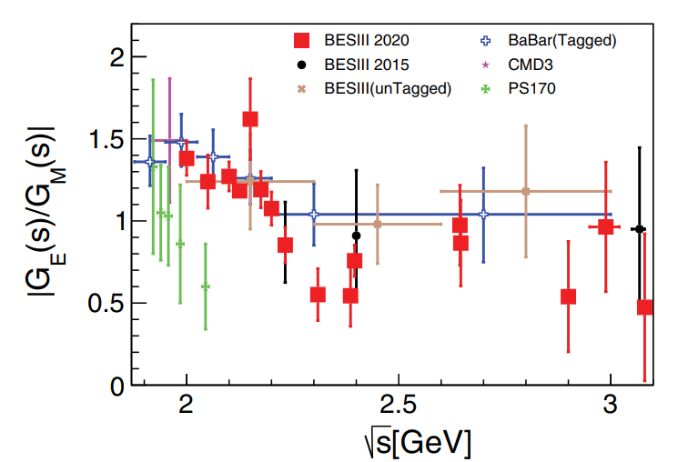
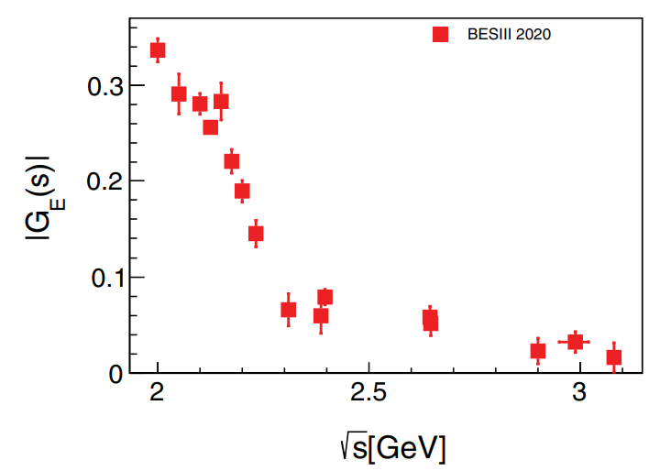
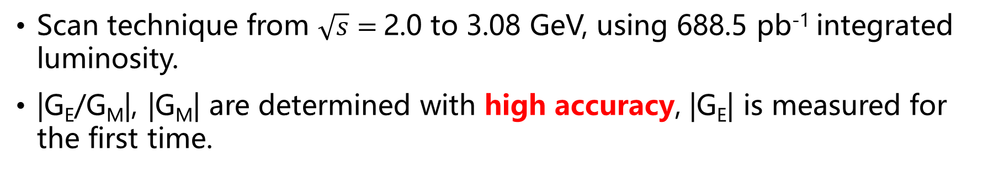
Recent results of proton EMFFs
Scan technique from $\sqrt{s}=$2.0 to 3.08 GeV, using 688.5 pb⁻¹ integrated luminosity.
|G_{E}/G_{M}|, |G_{M}| are determined with high accuracy, |G_{E}| is measured for the first time.
PRL 124, 042001 (2020)

Slide 16
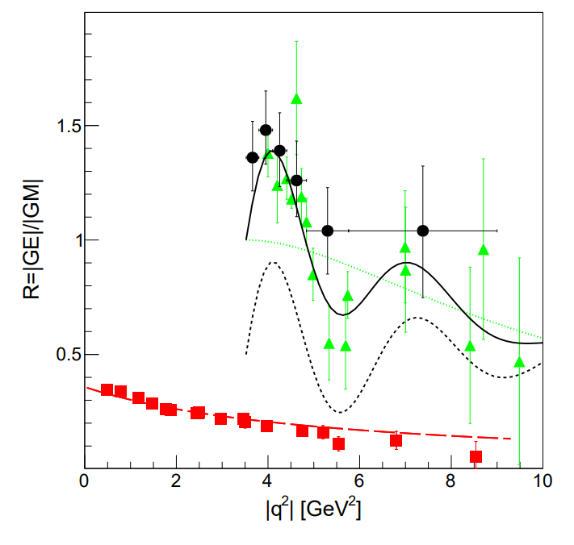


Analyticity of proton EMFFs
SL data shows a monotone decrease from ${1/μ}_{p}$ at $q^{2}=0$.
TL data decreases from 1 at threshold $q^{2}={4m}_{p}^{2}$.
Damped oscillation feature of |G_{E}/G_{M}| in Time-like
Perturbative domain has not been reached.
E. Tomasi-Gustafsson et al., PRC 103, 035203 (2021)

Slide 17




Timeline of Neutron EMFFs
Cross section
First result from FENICE, large cross section
SND scan near threshold, plateau behavior observed
BESIII and SND obtain precision results
|G_{E}/G_{M}|
Before 2000
2000 to 2020
2020
Year
No experimental result
BESIII measured |G_{E}/G_{M}| for the first time

Slide 18


Recent results of neutron EMFFs
$e^{+}e^{−}→n\overline{n}$ from $\sqrt{s}=$2.0-3.08 GeV, 647.9 pb⁻¹.
$γ−p$coupling larger than $γ−n$coupling => consistent with theoretical limits from VMD, Skyrme etc.
Oscillation of reduced-|G| observed in neutron with a phase orthogonal to that of proton.
Nat. Phys. 17, 1200–1204 (2021)

Slide 19



Recent results of neutron EMFFs
$e^{+}e^{−}→n\overline{n}$ from $\sqrt{s}=$1.884 to 2.007 GeV, ~30 pb⁻¹
$σ≈$ 0.4 nb below 2 GeV. Similar plateau as in $e^{+}e^{−}→p\overline{p}$.
Reduced-|G| contracts the common proton /neutron oscillation frequency.
Eur.Phys.J.C 82 (2022) 8, 761

Slide 20


Recent results of neutron EMFFs
Compared with the FENICE results, the values for |G_{M}| from this work are smaller by a factor of 2-3.
Results is compared with various models: pQCD, modified dipole, VMD and dispersion relations (DR), and DR model gives good consistency.
PRL 130, 151905 (2023)

Slide 21
Hyperons

Slide 22



From nucleon to hyperon
The hyperons can be produced in e⁺e⁻ annihilation above their production threshold
Cross section can be obtained very close to threshold with finite PHSP of final state
With hyperon weak decay to B+P, the polarization of hyperon can be measured, so does the relative phase between G_{E} and G_{M}

Slide 23





Cross section of $e^{+}e^{−}→Λ\overline{Λ}$
Let’s recall the Born cross section for $e^{+}e^{−}→B\overline{B}$:
$σ_{B\overline{B}}\left(q\right)=\frac{4πα^{2}Cβ}{3q^{2}}[|G_{M}\left(q\right)|^{2}+\frac{1}{2τ}|G_{E}(q)|^{2}$]
Coulomb factor: Charged $B\overline{B}$: C=$\frac{πα}{β}\frac{1}{1−exp (−\frac{πα}{β})}$, Neutral $B\overline{B}$: C=1
Near threshold, production cross section of neutral baryons should be zero
via Energy Scan
via ISR
PRD 97, 032013 (2018)
PRD 107, 072005 (2023)
PRD104, L091104(2021)
The anomalous behavior differing from the pQCD prediction at threshold is observed
Notes:
Lambda production at high energy region

Slide 24


Cross section of $e^{+}e^{−}→Λ\overline{Λ}$
Symmetry 14, 144(2022)

Slide 25





Relative phase of EMFFs
In time-like region, EMFFs can be complex
The non-zero relative phase between G_{E} and G_{M} gives transverse polarization of hyperons
$$P_{y}=−\frac{\sin{2θ}Im\left[G_{E}G_{M}^{∗}\right]/\sqrt{τ}}{\frac{{\left|G_{E}\right|}^{2}\sin^{2}θ}{τ}+{\left|G_{M}\right|}^{2}(1+\cos^{2}θ)}$$
The angular distribution of daughter baryon from Hyperon weak decay is:
$\frac{dσ}{dΩ}$ $∝1+α_{Λ}P_{y}∙\hat{q}$
$α_{Λ}$: asymmetry parameter
Anisotropic proton decay distribution
$$\frac{dN}{d\cos{θ}}=\frac{N_{0}}{2}\left(1+α_{Λ}P_{Λ}\cos{θ}\right)$$

Slide 26




Relative phase of Λ EMFFs
Matrix element of $e^{+}e^{−}→J/ψ→Λ\overline{Λ}$:
$ℳ=F_{1}γ_{μ}+\frac{F_{2}}{2m}q_{ν}σ^{νμ}γ_{5}+iε^{μναβ}\frac{σ_{αβ}}{4m}q_{v}F_{3}+\frac{1}{2m}\left(q^{μ}−\frac{q^{2}}{2m}γ^{μ}\right)γ_{5}F_{4}$
Differential cross section using spin density matrix and decay matrix
A correlated 5-dim. angular distribution $ξ=\left(θ_{Λ}, θ_{p}, φ_{p},θ_{\overline{p}},φ_{\overline{p}}\right)$with 4 parameters is constructed

Slide 27





Relative phase of Λ EMFFs
@ 2.396 GeV
@ 2.3864-3.08 GeV
RPL 123, 122003 (2019)
$$\left|\frac{G_{E}}{G_{M}}\right|=0.96±0.14\left(stat.\right)±0.02\left(sys.\right)$$
$$∆Φ={37}^{°}±{12}^{°}\left(stat.\right)±6^{°}\left(sys.\right)$$
(Confirm the complex form of EMFFs)
PRL 135, 191902 (2025)

Slide 28




Prediction of Λ EMFFs
Dispersion relations
PRD 104,116016 (2021)
PRD 103, 014028 (2021)
PRD 100, 073007(2019)
FSI in $Y\overline{Y}$ interaction
VMD model
Measurement of relative phase in a wide q² range would be crucial to enhance the predictive power of various model and test its asymptotic behavior in TL.

Slide 29






Cross section of $e^{+}e^{−}→\overline{Λ}Σ^{0}+c.c$
Nonzero Born cross section is observed at threshold, 72.9$±$12.6$±$5.4 pb
Fit function 1:
Fit function 2:
PRD 109,012002(2024）

Slide 30






Cross section of $e^{+}e^{−}→Σ\overline{Σ}$
Born cross sections of $e^{+}e^{−}→Σ^{+}{\overline{Σ}}^{−},$ $Σ^{−}{\overline{Σ}}^{+},$ $Σ^{0}{\overline{Σ}}^{0}$ are measured from threshold to 3.02 GeV
The decay process of $Σ^{+}→{pπ}^{0}$, $Σ^{−}→{nπ}^{−}$, $Σ^{0}→γΛ$ are reconstructed
None zero cross section near threshold observed for $Σ^{+}{\overline{Σ}}^{−},$ $Σ^{−}{\overline{Σ}}^{+}$ processes
$Σ^{±}{\overline{Σ}}^{∓}$:PLB 814, 136110 (2021)
$Σ^{0}{\overline{Σ}}^{0}$:PLB 831, 137187 (2022)

Slide 31





Cross section of $e^{+}e^{−}→Σ\overline{Σ}$
Born cross sections of $e^{+}e^{−}→Σ^{+}{\overline{Σ}}^{−},$ $Σ^{−}{\overline{Σ}}^{+},$ $Σ^{0}{\overline{Σ}}^{0}$ are measured from threshold to 3.02 GeV
The cross sections can be well described by pQCD-motivated functions
An asymmetry in cross sections for $Σ$ isospin triplets: $9.7±1.3 : 3.3±0.7 : 1$ =>related with valence quark?
$Σ^{±}{\overline{Σ}}^{∓}$:PLB 814, 136110 (2021)
$Σ^{0}{\overline{Σ}}^{0}$:PLB 831, 137187 (2022)

Slide 32



Relative phase of $Σ^{+}$ EMFFs
An event of the reaction $e^{+}e^{−}→Σ^{+}(→pπ^{0}){\overline{Σ}}^{−} (→\overline{p}π^{0})$ is formalized by the similar joint angular distribution.
Polarization is observed at $\sqrt{s}=$2.396, 2.644 and 2.90 GeV with a significance of 2.2$σ$, 3.6$σ$ and 4.1$σ$.
Relative phase is determined for the first time in a wide q² range.
PRL132,081904 (2024)

Slide 33



Complete measurement of $Σ^{+}$ EMFFs
|G_{E}/G_{M}| and $ΔΦ$ line-shape is compared with $\overline{Y}Y$ model different tendency in $ΔΦ$.
$ΔΦ$ distribution indicates there are integer multiples of π radians, from threshold to cross point.
The still increasing relative phase indicates the asymptotic threshold has not yet been reached.
PRL132,081904 (2024)

Slide 34




Cross section of $e^{+}e^{−}→Ξ\overline{Ξ}$
$Ξ^{0}{\overline{Ξ}}^{0}$:PLB 820, 136557 (2021)
$Ξ^{−}{\overline{Ξ}}^{+}:$PRD103, 012005(2021)
Born cross sections of ${e^{+}e^{−}→Ξ^{0}\overline{Ξ}}^{0}$ and $Ξ^{−}{\overline{Ξ}}^{+}$ are measured from threshold to 3.08 GeV
No significant threshold enhancement observed
The ratio of Born cross sections for both modes agrees with the expectation of isospin symmetry.

Slide 35





Cross section of $e^{+}e^{−}→Ω\overline{Ω}/Δ\overline{Δ}$
Born cross sections of $e^{+}e^{−}→Ω^{−}{\overline{Ω}}^{+}$ at 8 energy points between $\sqrt{s}=$3.49 and 3.67 GeV.
No significant signal observed.
Upper limit of effective FF is consistent with pQCD driven prediction.
$e^{+}e^{−}→Δ^{++}{\overline{Δ}}^{−−}$ is searched with c.m.s in 2.3094 to 2.6464 GeV.
No significant signal observed, but signal for $e^{+}e^{−}→Δ^{++}pπ^{−}$ observed.
PRD 107, 052003, 2023
PRD 108, 072010(2023)

Slide 36
Charmed baryons

Slide 37




Cross section of $e^{+}e^{−}→Λ_{c}^{+}{\overline{Λ}}_{c}^{−}$
The BESIII measurements indicate that there is indeed a step in $e^{+}e^{−}→Λ_{c}^{+}{\overline{Λ}}_{c}^{−}$, similar to $e^{+}e^{−}→p\overline{p}$, followed by a plateau.
PRL 120, 132001 (2018)
PRL131,191901 (2023)

Slide 38




EMFFs of $Λ_{c}^{+}$and proton
|G_{E}/G_{M}| is consistent with 1 near production threshold
Similar oscillation in $Λ_{c}^{+}$ |G_{E}/G_{M}| distribution as proton observed
proton
PRL131,191901 (2023)

Slide 39






Cross section of $e^{+}e^{−}→Λ_{c}^{+}{\overline{Λ}}_{c}^{∗−}$
$e^{+}e^{−}→Λ_{c}^{+}{\overline{Λ}}_{c}{(2595)}^{−}+c.c.$ and $e^{+}e^{−}→Λ_{c}^{+}{\overline{Λ}}_{c}{(2625)}^{−}+c.c.$ are measured for the first time at c.m. energies of 4.918 and 4.951 GeV.
Nonzero cross sections are observed very close to the production threshold.
PRD 109, L071104 (2024)
Notes:
Y(4660) is a Hidden charm Baryonium

Slide 40
Summary

Slide 41



TL baryon EMFFs
Updated from Nat.Sci.Rev. 8 (2021) 11, nwab187
Abnormal threshold effects observed in various baryon pair production: $p\overline{p}, Λ\overline{Λ}, Λ_{c}^{+}{\overline{Λ}}_{c}^{−}$ …
Oscillation structures observed in $p\overline{p}$, $n\overline{n}$
|G_{E}/G_{M}| ratio significantly larger than 1 at low beta for $p$, $Λ_{c}^{+}$, $Σ^{+},$ indicating large D-wave near threshold
Relative phase angle of form factor $∆φ$(sin$∆φ)$ measured for $Λ$, $Σ^{+},$ $Λ_{c}^{+}$
Notes:
Share feature of a plateau

Slide 42

Status of TL-EMFFs datasets
 | Energy scan $e^{+}e^{−}→B\overline{B}$ |  |  | ISR $e^{+}e^{−}→γ_{ISR}B\overline{B}$
 | Effective FF | |G_{E}/G_{M}| ratio | Relative phase | Effective FF | |G_{E}/G_{M}| ratio | Relative phase
$$p$$ | Over 30 energy points, $q∈\left(1.877, 3.08\right)$ GeV, best precision: 2% | 16 energy points, $q∈\left(2.0, 3.08\right)$ GeV, best precision: 3% | - | c.m.e=3.773- 4.6, 10.58 GeV, $q∈\left(1.877, 3.08\right)$ GeV, best precision: 5% | 15 energy intervals, $q∈\left(1.88, 3\right)$ GeV, best precision: 20% | -
$$n$$ | ~20 energy points, $q∈\left(1.877, 3.08\right)$ GeV, best precision: 5% | 5 intervals with $q∈\left(2.0, 3.08\right)$ GeV, best precision: 20% | - | - | - | -
$$Λ$$ | Over 40 energy points, $q∈\left(2.2324, 4.6\right)$ GeV, best precision: 2% | 6 energy points, $q∈\left(2.3864, 3.08\right)$ GeV, best precision: 10% | 5 energy points, $q∈\left(2.3864, 3.08\right)$ GeV, best precision: 10˚ | c.m.e=3.773- 4.26, 10.58 GeV, 20 energy intervals, ~500 events | - | -
$$Λ{\overline{Σ}}^{0}$$ | 14 energy points, $q∈\left(2.3094, 3.08\right)$ GeV, best precision: 4% | - | - | c.m.e=10.58 GeV, 5 energy intervals, ~25 events | - | -

Slide 43

Status of TL-EMFFs datasets
 | Energy scan $e^{+}e^{−}→B\overline{B}$ |  |  | ISR $e^{+}e^{−}→γ_{ISR}B\overline{B}$
 | Effective FF | |G_{E}/G_{M}| ratio | Relative phase | Effective FF | |G_{E}/G_{M}| ratio | Relative phase
$$p$$ | Over 30 energy points, $q∈\left(1.877, 3.08\right)$ GeV, best precision: 2% | 16 energy points, $q∈\left(2.0, 3.08\right)$ GeV, best precision: 3% | - | c.m.e=3.773- 4.6, 10.58 GeV, $q∈\left(1.877, 3.08\right)$ GeV, best precision: 5% | 15 energy intervals, $q∈\left(1.88, 3\right)$ GeV, best precision: 20% | -
$$n$$ | ~20 energy points, $q∈\left(1.877, 3.08\right)$ GeV, best precision: 5% | 5 intervals with $q∈\left(2.0, 3.08\right)$ GeV, best precision: 20% | - | - | - | -
$$Λ$$ | Over 40 energy points, $q∈\left(2.2324, 4.6\right)$ GeV, best precision: 2% | 6 energy points, $q∈\left(2.3864, 3.08\right)$ GeV, best precision: 10% | 5 energy points, $q∈\left(2.3864, 3.08\right)$ GeV, best precision: 10˚ | c.m.e=3.773- 4.26, 10.58 GeV, 20 energy intervals, ~500 events | - | -
$$Λ{\overline{Σ}}^{0}$$ | 14 energy points, $q∈\left(2.3094, 3.08\right)$ GeV, best precision: 4% | - | - | c.m.e=10.58 GeV, 5 energy intervals, ~25 events | - | -

Slide 44

A summary of TL-EMFFs
 | Energy scan $e^{+}e^{−}→B\overline{B}$ |  |  | ISR $e^{+}e^{−}→γ_{ISR}B\overline{B}$
 | Effective FF | |G_{E}/G_{M}| ratio | Relative phase | Effective FF | |G_{E}/G_{M}| ratio | Relative phase
$$Σ^{+}$$ | 8 energy points, $q∈\left(2.3864, 3.08\right)$ GeV, best precision: 6% | 3 energy points, $q∈\left(2.36, 3.08\right)$ GeV, best precision: 20% | 3 energy points $q∈\left(2.3864, 2.90\right)$ GeV, best precision: 20˚ | c.m.e=3.773-4.258 GeV, 11 energy intervals, ~180 events | - | -
$$Σ^{0}$$ | 7 energy points, $q∈\left(2.3864, 3.08\right)$ GeV, best precision: 6% | - | - | c.m.e=10.58 GeV, 5 energy intervals, ~20 events | - | -
$$Σ^{−}$$ | 6 energy points, $q∈\left(2.396, 3.08\right)$ GeV, best precision: 12% | - | - | - | - | -
$Ξ^{0}$/$Ξ^{−}$ | ~10 energy points, $q∈\left(2.644, 3.08\right)$ GeV, best precision: 12% | - | - | - | - | -
$$Λ_{c}^{+}$$ | 16 energy points, , $q∈\left(4.59, 4.95\right)$ GeV, best precision: 2% | 16 energy points, $q∈\left(4.59, 4.95\right)$ GeV, best precision: 4% | 13 energy points $q∈\left(4.6, 4.95\right)$ GeV, best precision: 4˚ | / | / | /

Slide 45
Summary
Fruitful physics results of EMFFs from e⁺e⁻ colliders, via energy scan and ISR methods.
Conventional parameterization of EMFFs is facing challenge from experimental observations (threshold effect, oscillation in reduced FFs and |G_{E}/G_{M}| ratio).
Relative phase of EMFFs gives rise to polarization of final baryons, and will play an important role in distinguishing various theoretical models.

Slide 46
Thank you!

